Slide 1
Class vs ID Selectors
What they are and how to use them.

Slide 2
What are the differences?
Class Selectors
ID Selectors
Utilized to select many objects on the page.
Allows for multiple selections
Items can have more then one class selector
This should be your default way to select items
Used to select single items on the page
Allows for a single selection
No more then one ID per item per page
Best when used with JavaScript

Slide 3
Class Selectors
Class Selectors are the default way to work on designing within CSS the utility of being able to select every item on the page that you need by assigning it to a class simplifies and improves both readability and speed at which the code can be executed.

Slide 4
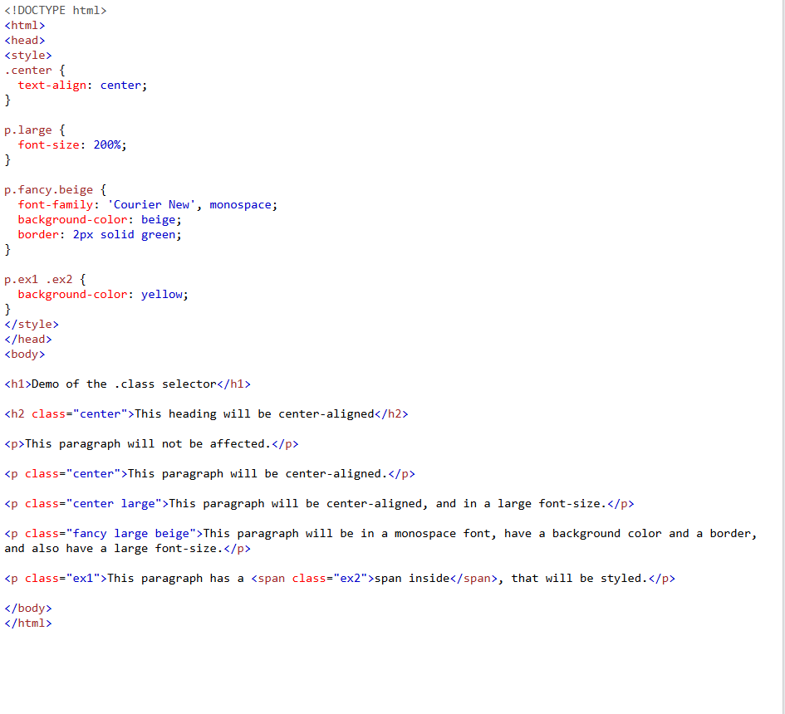
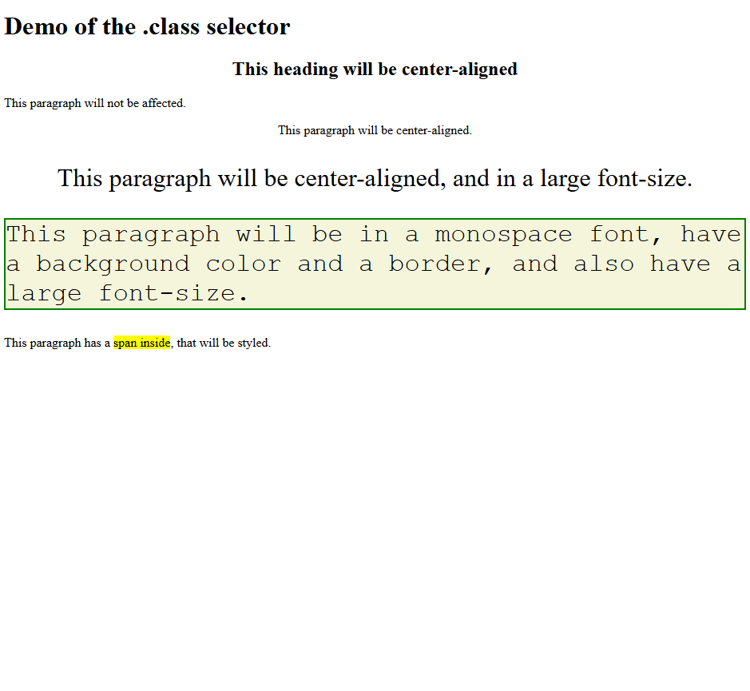
Multiple Class Selections

Slide 5
Selecting a class attribute
For the CSS and HTML to work together there needs to be a selection made. Within the HTML there needs to be a class attribute made such as:
<p class= “class”>This has an attribute of ‘class’</p>
For the CSS to access this it doesn’t just take the word ‘class’, rather you need to define it as a class within the CSS this is done by placing a period before the class attribute:
.class {
color: red;
}
This would display as such: This has an attribute of ‘class’

Slide 6
ID Selectors
ID Selectors are specialized in the fact that you may only have one of them per page, they are used for individual items such as pictures, or for items that need specific direction such as those affected by JavaScript. ID selectors while not bad should be avoided if a class selector would work more efficiently in its place. Every time you place an ID selector you should evaluate it if there isn’t a way to use a class selector.

Slide 7
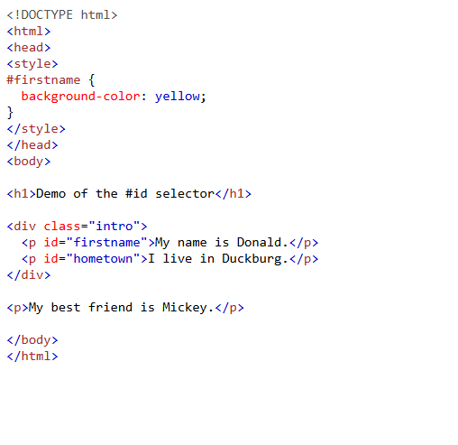

Single ID Selections

Slide 8
Selecting a ID attribute
For the CSS and HTML to work together there needs to be a selection made. Within the HTML there needs to be a ID attribute made such as:
<p ID= “ID”>This has an attribute of ‘ID’</p>
For the CSS to access this it doesn’t just take the word ‘ID’, rather you need to define it as a ID within the CSS this is done by placing a pound symbol (hashtag) before the class attribute:
#ID {
color: red;
}
This would display as such: This has an attribute of ‘ID’

Slide 9

Conclusion
While both Class and ID selectors are useful in their own right the differences is where they truly shine. The Class attribute is great for affecting many objects and simplifying the entirety of your code. While the power to individually select an object while using an ID attribute really allows for dynamics that the Class attribute can’t compete with.
Remember to use both and code responsively.

